Slide 1
Boolean functions homework
Hognogi Ana-Maria Cristina – Group 913

Slide 2
Exercise 3.3
Using Veitch diagrams, simplify the following Boolean function:

Slide 3
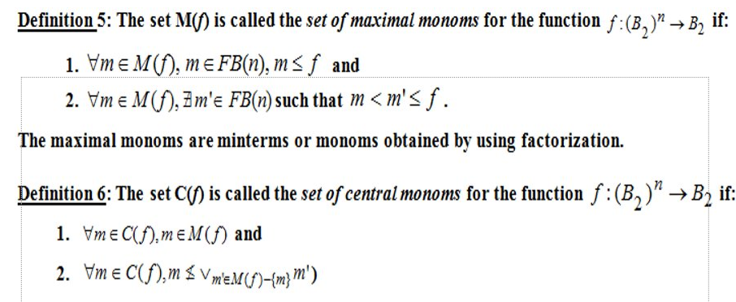
Theoretical results

Slide 4
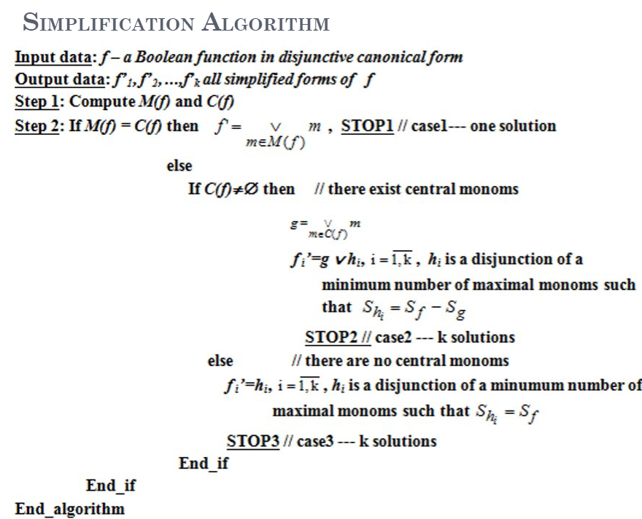

Slide 5
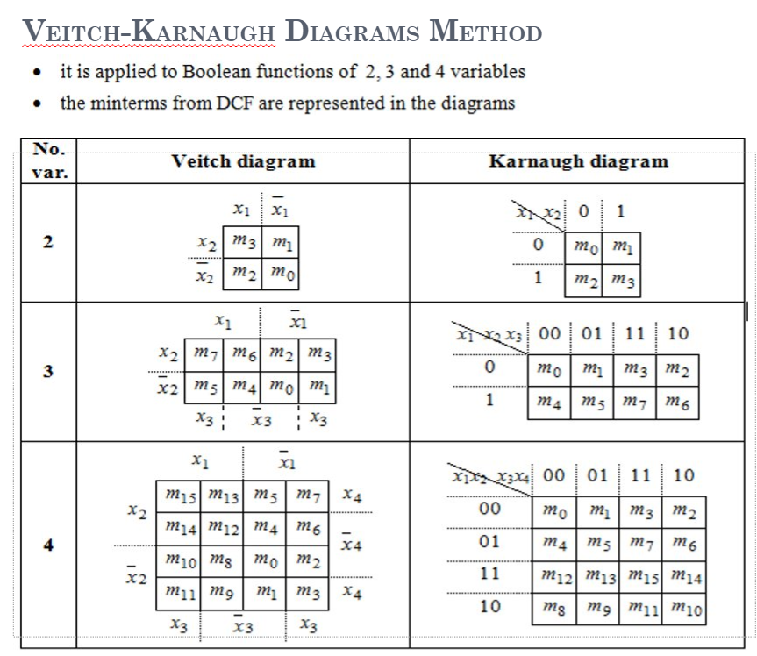

Slide 6
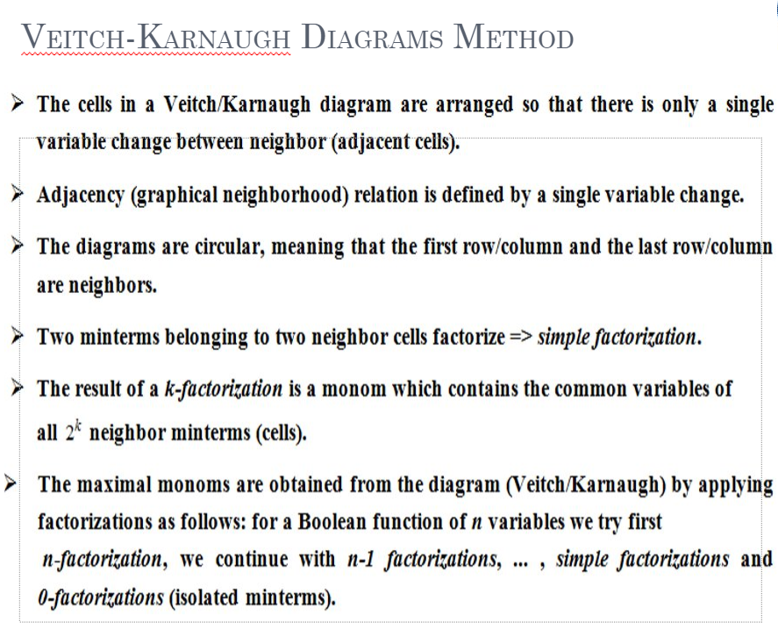

Slide 7
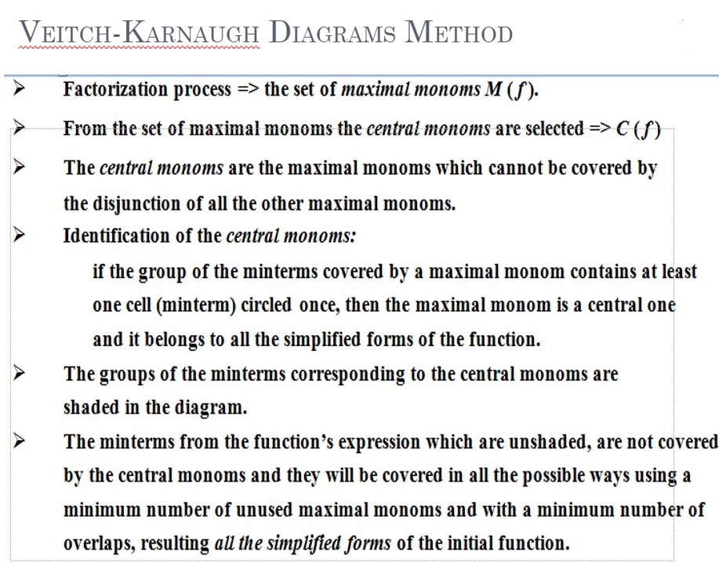

Slide 8
Solution

Slide 9
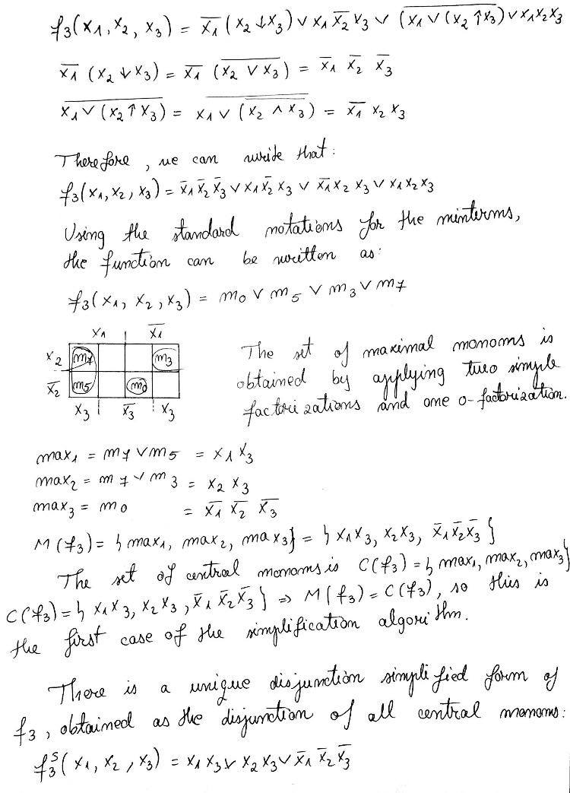
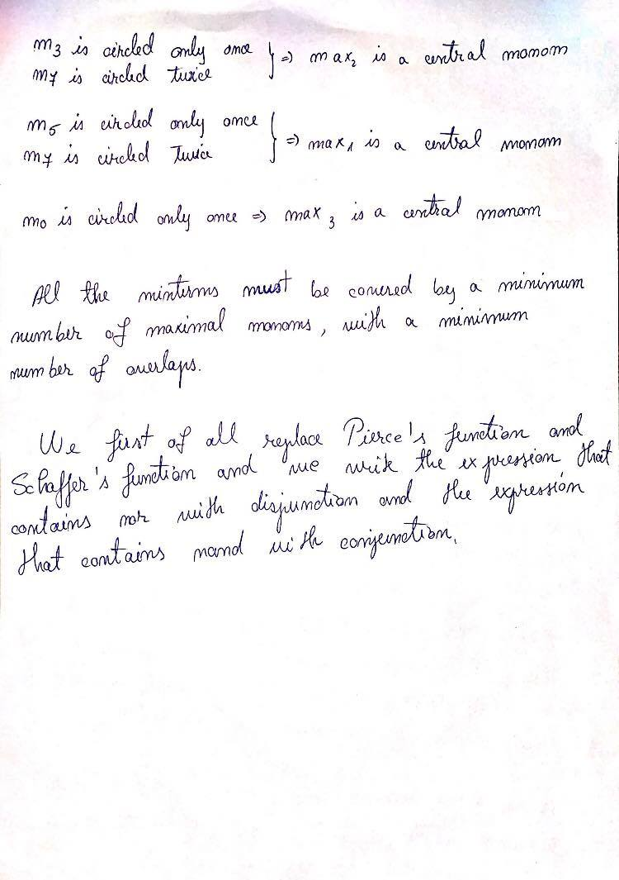

Slide 10
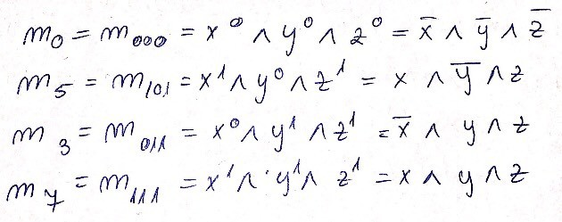

Slide 12
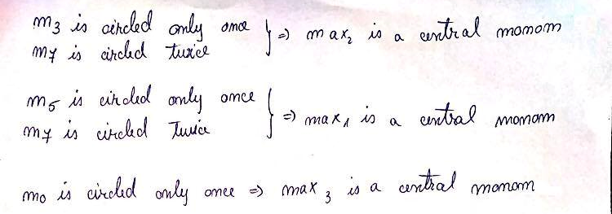

Slide 13



Slide 14
Conclusion

Slide 15


